Slide 1
Lecture 1
Data Warehousing and Mining

Slide 2
Text Book to be followed
Data Mining Concepts and Techniques
Written by : Han & Kamber

Slide 3

A producer wants to know….
Which are our
lowest/highest margin
customers ?
Who are my customers
and what products
are they buying?
What is the most
effective distribution
channel?
What product prom-
-otions have the biggest
impact on revenue?
Which customers
are most likely to go
to the competition ?
What impact will
new products/services
have on revenue
and margins?

Slide 4
Data, Data everywhere yet ...
I can’t find the data I need
  data is scattered over the network
  many versions, subtle differences
I can’t get the data I need
  need an expert to get the data
I can’t understand the data I found
  available data poorly documented
I can’t use the data I found
  results are unexpected
  data needs to be transformed from one form to other

Slide 5

What is a Data Warehouse?
A single, complete and consistent store of data obtained from a variety of different sources made available to end users in a format what they can understand and can be used in a business context.
[Barry Devlin]

Slide 6
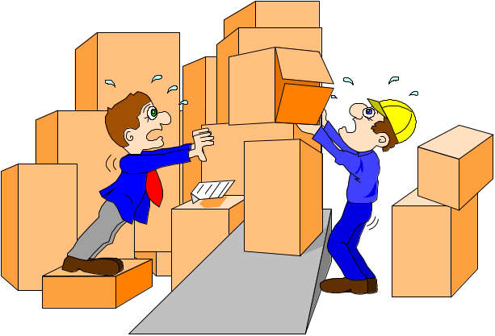
What are the users saying...
Data should be integrated across the enterprise
Summary data has a real value to the organization
Historical data holds the key to understanding data over time
What-if capabilities are required

Slide 7
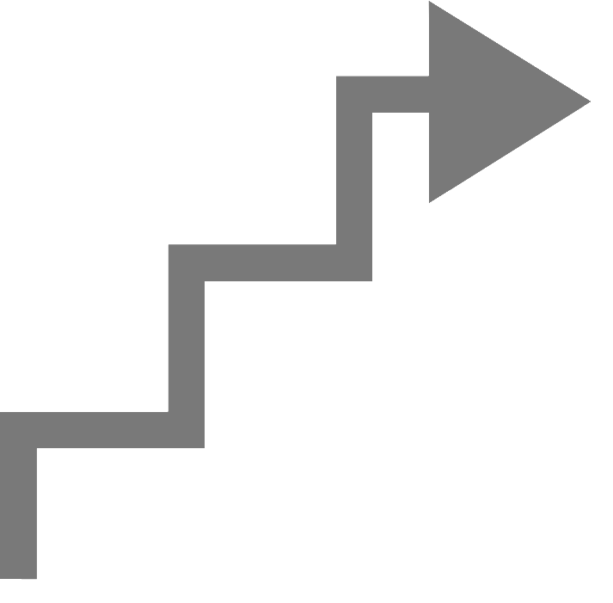
What is Data Warehousing?
A process of transforming data into information and making it available to users in a timely enough manner to make a difference
The critical factor leading to the use of a data warehouse is that a data analyst can perform complex queries and analysis on the information without slowing down the operational systems.
Information
Data

Slide 8
Evolution
60’s: Batch reports
  hard to find and analyze information
  inflexible and expensive, reprogram every new request
70’s: Terminal-based DSS and EIS (executive information systems)
  still inflexible, not integrated with desktop tools
80’s: Desktop data access and analysis tools
  query tools, spreadsheets, GUIs
  easier to use, but only access operational databases
90’s: Data warehousing with integrated OLAP engines and tools

Slide 9
Warehouses are Very Large Databases
35%
30%
25%
20%
15%
10%
5%
0%
Respondents
Initial
Projected 2Q96
Source: META Group, Inc.
5GB
10-19GB
50-99GB
250-499GB
5-9GB
20-49GB
100-249GB
500GB-1TB

Slide 10
Very Large Data Bases
Terabytes -- 10^12 bytes:
Petabytes -- 10^15 bytes:
Exabytes -- 10^18 bytes:
Zettabytes -- 10^21 bytes:
Zottabytes -- 10^24 bytes:

Slide 11

Data Warehousing --
It is a process
Technique for assembling and managing data from various sources for the purpose of answering business questions. Thus making decisions that were not previous possible
A decision support database maintained separately from OLTP

Slide 12
Data Warehouse
A data warehouse is a
  subject-oriented
  integrated
  time-varying
  non-volatile
collection of data that is used primarily in organizational decision making.
  -- Bill Inmon, Building the Data Warehouse 1996

Slide 13


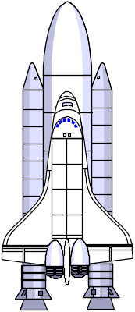
Explorers, Farmers and Tourists
Tourists: Browse information harvested by farmers
Farmers: Harvest information
from known access paths
Explorers: Seek out the unknown and previously unsuspected rewards hiding in the detailed data

Slide 14
Data Warehousing : Characteristic
  Subject oriented
  Integrated
  Time variant (time series)
  Nonvolatile
  Web based
  Relational/multidimensional
  Client/server
  Real-time
  Include metadata

Slide 15
Data Warehousing
Data mart
A departmental data warehouse that stores only relevant data
Dependent data mart
A subset that is created directly from a data warehouse
Independent data mart
A small data warehouse designed for a strategic business unit or a department

Slide 16
Data Warehousing
“Manufacturing and using data warehouse”

Slide 17
Data Warehousing
Enterprise data warehouse (EDW)
A technology that provides a vehicle for pushing data from source systems into a data warehouse
Metadata
Data about data. In a data warehouse, metadata describe the contents of a data warehouse and the manner of its use

Slide 18
Data Warehousing
Process Overview
Organizations continuously collect data, information, and knowledge at an increasingly accelerated rate and store them in computerized systems
The number of users needing to access the information continues to increase as a result of improved reliability and availability of network access, especially the Internet

Slide 19
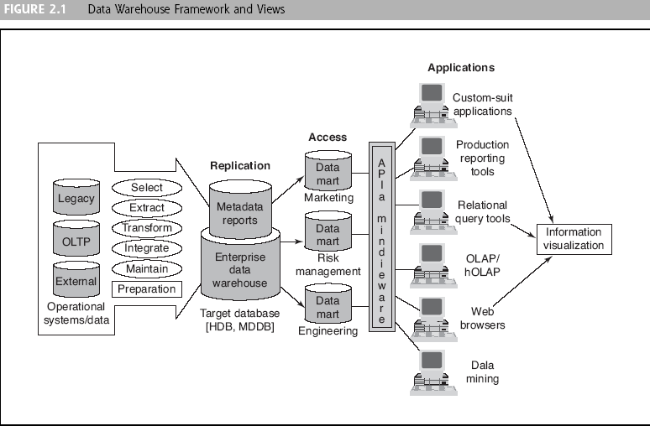
Data Warehousing
Process Overview

Slide 20
Data Warehousing
Process Overview
The major components of a data warehousing process
  Data sources
  Data extraction
  Data loading
  Comprehensive database
  Metadata
  Middleware tools

